Slide 1
RESTful Web Services
Prepared by Under Guidance
Dhanraj Wanjare (13/CA/644) Dr. Arinban Sarkar

Slide 2
Introduction to RESTful Web Service
RESTful Web Services are REST architecture based web services. In REST Architecture everything is a resource. RESTful web services are light weight, highly scalable and maintainable and are very commonly used to create APIs for web based applications.

Slide 3
Java API for RESTful Web Services (JAX-RS)
JAX-RS stands for JAVA API for RESTful Web Services. JAX-RS is a JAVA based programming language API and specification to provide support for created RESTful Webservices.
Standard annotation-driven API that aims to help developer build RESTful Web Services in Java.

Slide 4
Objective of RESTful web services
Exposing the existing function on the network : A RESTful web service is a unit of managed code that can be remotely invoked using HTTP,that is,it can be activated using HTTP request.RESTful web service allow us to expose the functionality of our existing code over the network.Once it is exposed on the network ,other application can use the functionality of our program.
Interoperability : RESTful web service allow various application to talk to each other and share data and service among them.For Example .Net application can talk to java web services.

Slide 5
Annotation provided by JAX-RS
@Path Relative path of the resource class/method.
@GET HTTP Get request, used to fetch resource.
@PUT HTTP PUT request, used to create resource.
@POST HTTP POST request, used to create/update resource.
@DELETE HTTP DELETE request, used to delete resource.
@HEAD HTTP HEAD request, used to get status of method availability.
@Produces States the HTTP Response generated by web service, for example APPLICATION/XML, TEXT/HTML, APPLICATION/JSON etc.

Slide 6
@Consumes States the HTTP Request type, for example application/x-www-form-url encoded to accept form data in HTTP body during POST request.
@PathParam Binds the parameter passed to method to a value in path.
@QueryParam Binds the parameter passed to method to a query parameter in path.
@HeaderParam Binds the parameter passed to method to a HTTP header.
@FormParam Binds the parameter passed to method to a form value.
@Context Context of the resource for example HTTPRequest as a context.

Slide 7
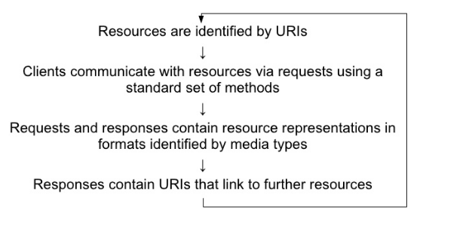
RESTful Application Cycle

Slide 8
Example of RESTful Web Services using JAX-RS
URI: https://www.restfulservice.com/service/webapi/properties/12
@Path(“properties/{id_no}”)
public class Details
{
@GET
@Produces(MediaType.Application_Json)
public String getDetails(@PathParam(“id_no”) String id)
{
………………
………………
return(“id Detail”);
}
}
<servlet-mapping>
<servlet-name>Jersey Web Application</servlet-name>
<url-pattern>/webapi/*</url-pattern>
</servlet-mapping>
<init-param>
<param-name>jersey.config.server.provider.packages</param-name>
<param-value>org.dhanji.company.Service</param-value>
</init-param>

Slide 9
Project Explanation
Project Include
Upload file
Search File
Download File

Slide 10
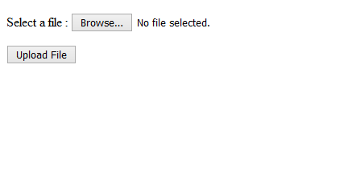
Upload File URL :-http://localhost:9595/Service/FileUpload.jsp

Slide 11
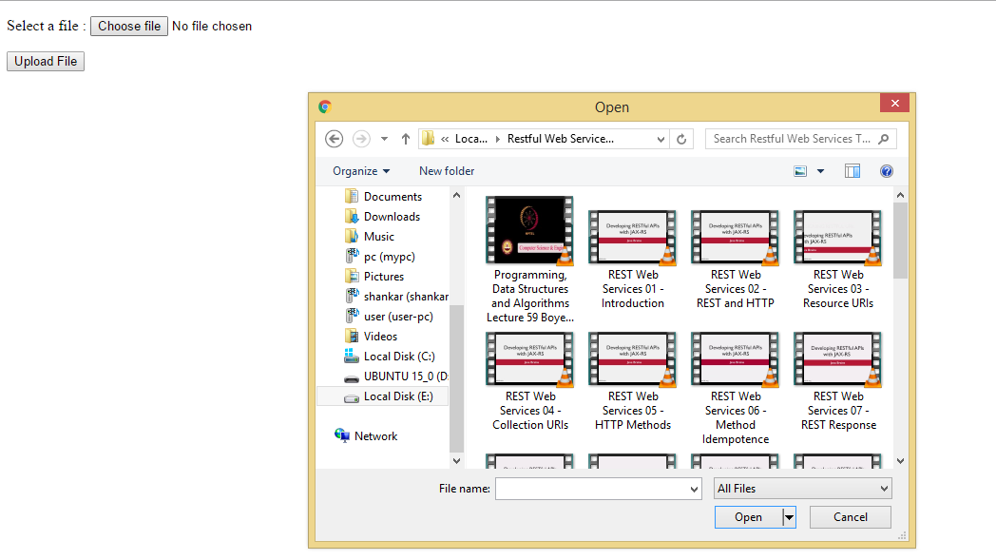
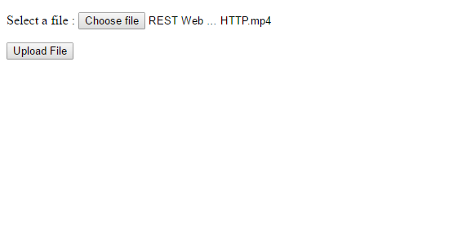

Slide 12
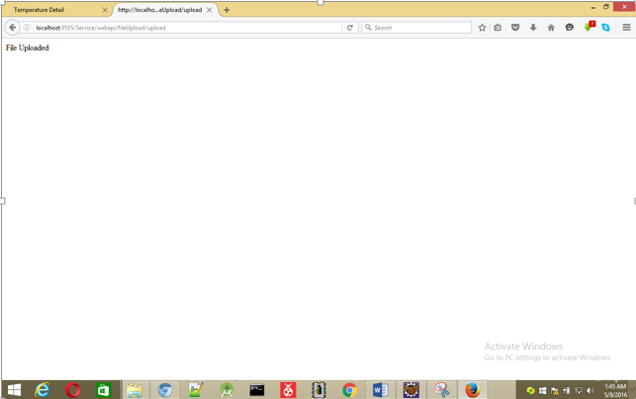

Slide 13
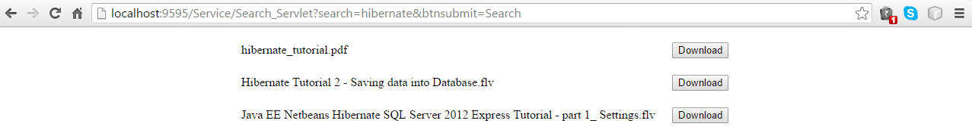
Search File URL http://localhost:9595/Service/Download_File.jsp

Slide 14
Thank you

